Slide 1

Analysis of Call Logs and Organizational Engagement
SAFARKHAN S

Slide 2
Introduction
Objective
Understand engagement patterns with organizations based on renewal status.
Assess call strategies and identify regional performance.
Identify common issues with call connections.

Slide 3
Methodology
Data Sources:
Call logs
Organizational details
Analysis Techniques:
SQL queries
Data aggregation and analysis

Slide 4
First Connected Call for Renewed Organizations in Gujarat
org_id | org_name | org_code | first_connected_call_date
55 | Company E | BIZ | 22-06-2023 15:38
88 | Company H | BJI | 26-05-2023 17:29
777 | Company P | BJM | 24-05-2023 15:16
888 | Company Q | BJP | 26-05-2023 14:27
999 | Company R | BJR | 23-05-2023 11:31
1111 | Company S | BJT | 20-06-2023 17:02
Observation:
Highlight that these are the first connected call dates for renewed organizations located in Gujarat.

Slide 5
Count of Organizations with Three Consecutive Calls
Summary Table:
Status | 0-4 days | 15-8 days | 8-15 days | 16-30 days | 30+ days
Not Renewed | 6 | 0 | 0 | 0 | 1
Renewed | 8 | 1 | 0 | 2 | 1
Observation:
Higher engagement is observed within the first 4 days for renewed organizations compared to not renewed ones.

Slide 6
Location with Maximum Number of Connected Calls
Summary Table:
Location | Unique Lead Count | Total Connected Calls
Maharashtra | 76 | 77
Observation:
Maharashtra has the highest number of unique leads and total connected calls, indicating strong regional engagement.

Slide 7
Most Common Reasons for Unconnected Calls
Summary Table:
Call Not Connected Reason | Reason Count
NOT_PICKED | 107
BUSY | 16
INVALID_NUMBER | 15
SWITCH_OFF | 14
OTHER REASONS | 46
Observation:
"NOT_PICKED" is the most frequent reason for unconnected calls, suggesting a need for better call management or follow-up strategies.

Slide 8
Summary of Analysis
1. First Connected Call for Renewed Organizations in Gujarat
Renewed organizations in Gujarat showed prompt initial engagement through early connected calls.
2. Count of Organizations with Consecutive Calls
Renewed organizations had higher instances of three consecutive calls within the first 4 days compared to non-renewed ones.
3. Location with Maximum Number of Connected Calls
Maharashtra recorded the highest number of unique leads and connected calls, indicating strong regional engagement.
4. Most Common Reasons for Unconnected Calls
"NOT_PICKED" was the predominant reason for unconnected calls, highlighting potential issues in contact timing or availability.
Overall Inferences
Early and frequent engagement correlates with renewal rates, with regional performance and call connection issues offering targeted areas for improvement.

Slide 9
Appendices
SQL Queries:
List of SQL queries used for analysis:
Find first connected call for renewed organizations in Gujarat
Count of organizations with three consecutive calls categorized by days since creation
Identify the location with the maximum number of connected calls
Most common reasons for unconnected calls

Slide 10
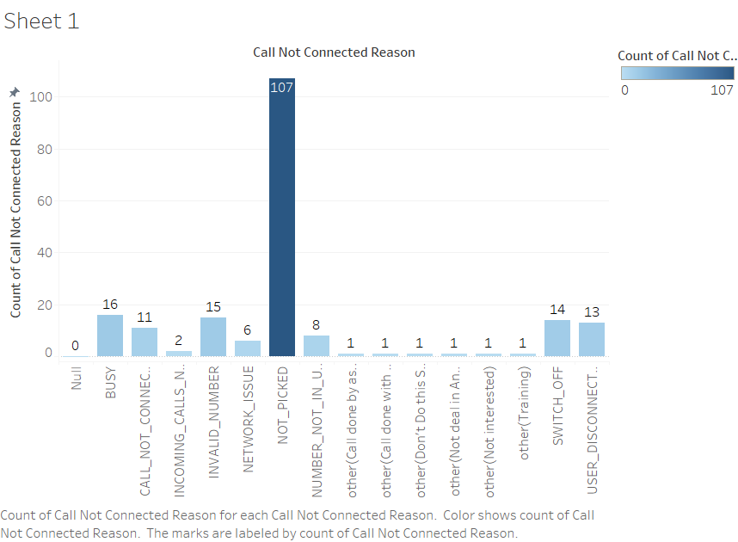
Appendices
Chart:
Most common reasons for unconnected calls

Slide 11
THANKS

